Slide 1
Yarning Circle Prom Hill Charter
Item | Comments
Rules for use of the space | No Alcohol and no smoking at the site Events to be organised must be verified with the site owner
Appropriate use – encouraged use of the space | Formal handover to when the space is open and accessible (Spirit / PSI / Newsletter/ Face to Face) A place to sit and talk with teammates Place for quiet reflection
Strategic use of the space for Indigenous Staff | AMYAC Cultural Training team to be present at the space with a fire – promote this…Spirit? Aboriginal and Torres Strait employee only sessions (once a quarter) SLT / Diagonal Slice meeting (once a quarter)
Opening event criteria – for EOI | Welcome to country Smoking Ceremony Traditional Dance ‘Inma‘ Delivery of event to be from registered AMYAC members with appropriate cultural knowledge to deliver the event
Administrative questions – additions/ upgrades | How to book the area for team use (Outlook online booking) Who verifies the booking and use ?

Slide 2
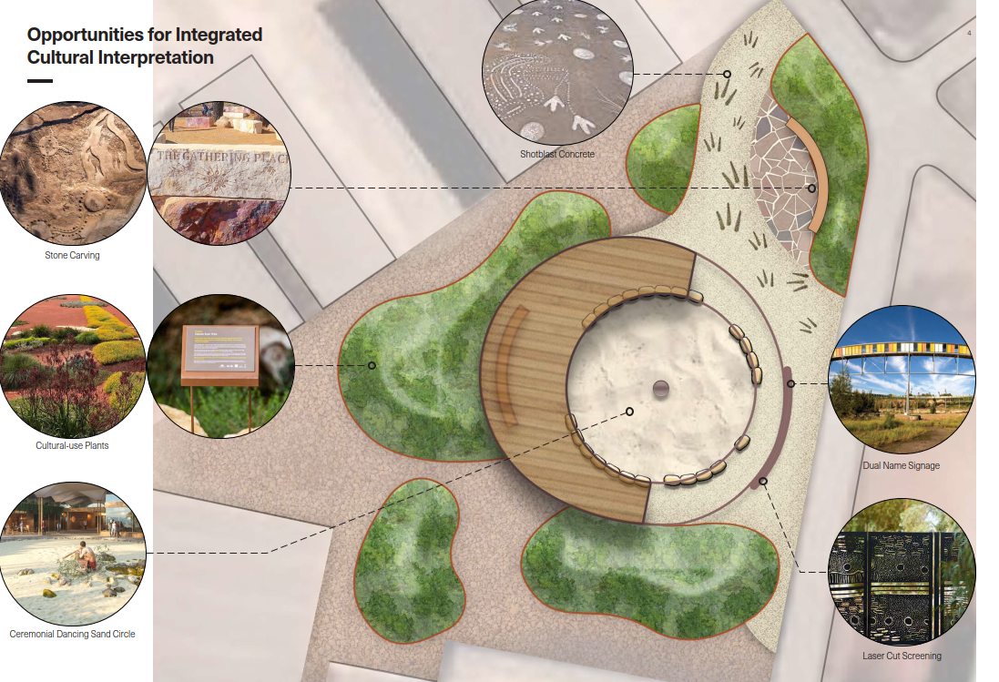

Slide 3
